Slide 1
12 Factor Apps and Redhat OpenShift Demo
-Raghu

Slide 2
Agenda
The Twelve-Factor App
Monolithic Applications
Introduction to MicroService
12 Factors for success
Introductory demo on Redhat OpenShift

Slide 3

The Twelve-Factor App
Achieve Zero Downtime
Remove Maintenance Window
Release software anytime of the day
Best Practices
Principles
Scaling

Slide 4
Monolithic Applications
Tight coupling between components. Limited application ownership
All components within application have to be coded in same lauguage
Huge Codebase.
Long deployment cycles.
Scaling cant be dynamic.
Fix in a component needs, application deployment
Difficult to provide zero downtime

Slide 5
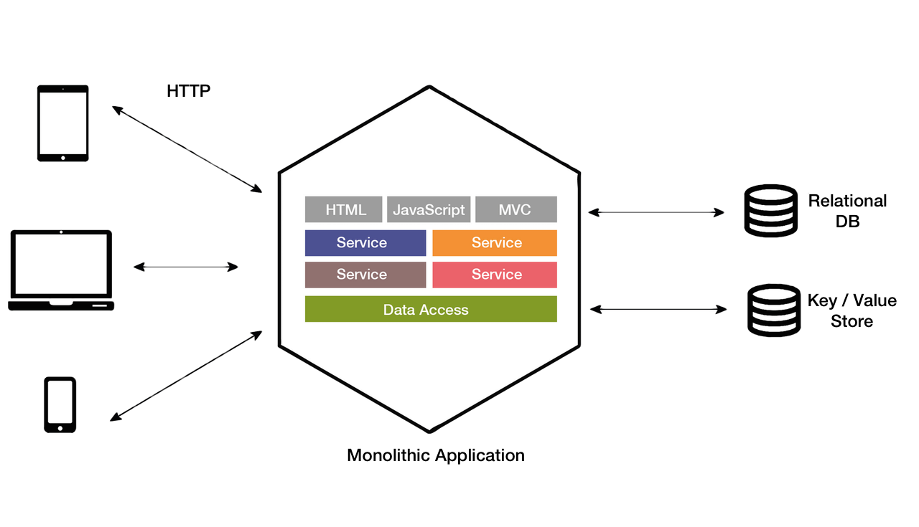
Monolithic Applications

Slide 6

Introduction to Microservices
Single Responsibility Principle
Typically needs to adopt devops model
Independently managed.
Each component can be developed with different language. (though many practitioners discourage it)
Faster and simpler deployments and rollbacks
Ability to provide zero downtime

Slide 7
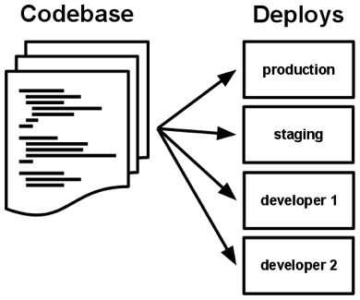
12 Factors for success
Code Base - A codebase is any single repo (in a centralized revision control system like Subversion), or any set of repos who share a root commit (in a decentralized revision control system like Git).
If there are multiple codebases, it’s not an app – it’s a distributed system. Each component in a distributed system is an app, and each can individually comply with twelve-factor.

Slide 8
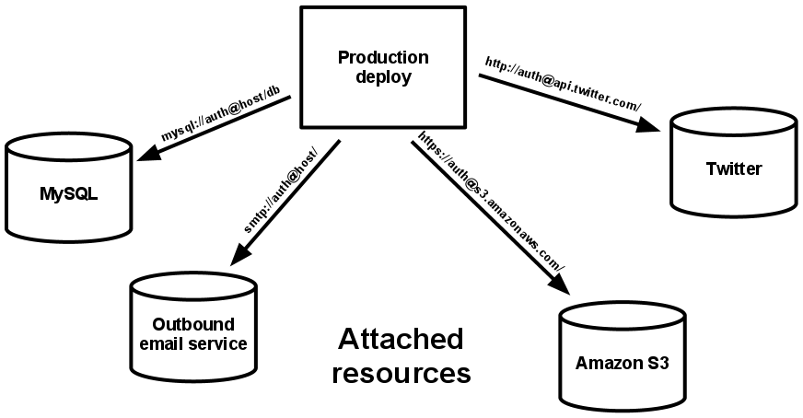
12 Factors for success
Dependencies - Most programming languages offer a packaging system for distributing support libraries, like maven for Java, NPM for Node.
Configuration – There should not be a repacking of application when promoting code from one environment to another. Individual configuration can be stored in cloud server and loaded at runtime.
Backing services – Treating the backing services as attached resources. A deploy of the twelve-factor app should be able to swap out a local MySQL database with one managed by a third party (such as Amazon Data store) without any changes to the app’s code

Slide 9
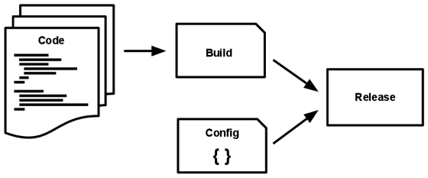
12 Factors for success
Build, release, run - The build stage is a transform which converts a code repo into an executable bundle known as a build. Using a version of the code at a commit specified by the deployment process, the build stage fetches vendors dependencies and compiles binaries and assets.
The release stage takes the build produced by the build stage and combines it with the deploy’s current config. The resulting release contains both the build and the config and is ready for immediate execution in the execution environment.
The run stage (also known as “runtime”) runs the app in the execution environment, by launching some set of the app’s processes against a selected release.
Never suggests Hotfixes

Slide 10
12 Factors for success
Processes - Execute the app as one or more stateless processes. Twelve-factor processes are stateless and share-nothing. Any data that needs to persist must be stored in a stateful backing service, typically a database.
Port binding - Export services via port binding. In a local development environment, the developer visits a service URL like http://localhost:5000/ to access the service exported by their app. In deployment, a routing layer handles routing requests from a public-facing hostname to the port-bound web processes.

Slide 11
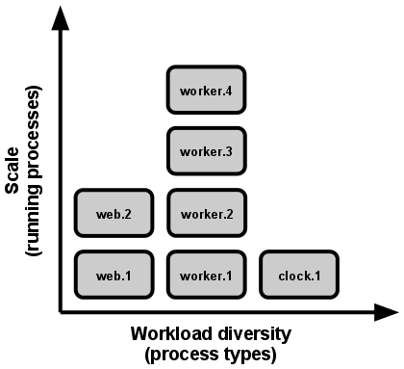
12 Factors for success
Concurrency - Java processes take the approach of, JVM providing one massive uberprocess that reserves a large block of system resources (CPU and memory) on startup, with concurrency managed internally via threads. In both cases, the running process(es) are only minimally visible to the developers of the app

Slide 12
12 Factors for success
Disposability - Maximize robustness with fast startup and graceful shutdown. The twelve-factor app’s processes are disposable, meaning they can be started or stopped at a moment’s notice. This facilitates fast elastic scaling, rapid deployment of code or config changes, and robustness of production deploys.
Start with refusing new requests, and then shutdown the application
Dev/prod parity - Keep development, staging, and production as similar as possible.

Slide 13
12 Factors for success
Logs - Treat logs as event streams. Logs provide visibility into the behavior of a running app. In server-based environments they are commonly written to a file on disk (a “logfile”); but this is only an output format.
Finding specific events in the past.
Large-scale graphing of trends (such as requests per minute).
Active alerting according to user-defined heuristics (such as an alert when the quantity of errors per minute exceeds a certain threshold).
Admin processes - Run admin/management tasks as one-off processes

Slide 14

Demo on Redhat Openshift

Slide 15
THANK YOU
Ref: https://www.brighttalk.com/webcast/14777/266613?utm_campaign=webcasts-search-results-feed&utm_content=12%20factor%20apps&utm_source=brighttalk-portal&utm_medium=web

